Slide 1
Air Quality Trends in the Neighborhoods of New York City for People Suffering from Asthma
Track 1 Final Paper
Anish Gupta
Email: anish.gupta@rutgers.edu
Number of Slides: 3

Slide 2
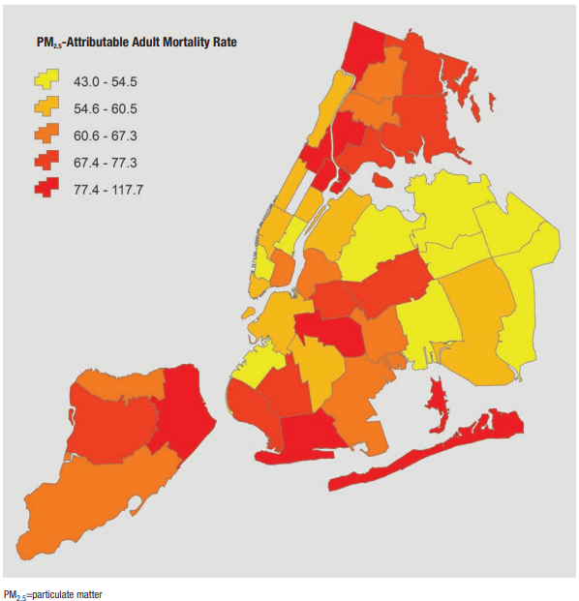
Project Significance
Topic: Air Quality
Significance:
PM2.5 is a small particulate matter that is an air pollutant and contributes to 2000 deaths and 5150 as of 2021.
Thousands of patients visit the emergency department and are hospitalized with asthma, heart, and lung problems.
Older adults, children, and people with preexisting conditions are most at risk
This system will show the air quality trends and the stakeholders will have a better understanding changes in air quality over time by neighborhoods.
This will help residents who suffer from respiratory illnesses of New York City identify neighborhoods they should choose to live in
For residents that cannot afford to move, will be able to use this this information to file a complaint to city officials regarding pollution related healthcare access
Stakeholders:
Healthcare providers
First Respondents
Patients
Policy Makers
City Planners
Notes:
In New York City thousands of patients visit the Emergency room, are hospitalized and even face untimely death due to pollution related asthma, heart and lung problems.
In this study I specifically look at a pollutant called PM2.5 and its impact on asthma. PM2.5 are small particles in the air that are <= 2.5 micrometers and are so small that they can be inhaled and cause serious health problems.
They are capable of getting deep inside a person’s lungs and also into the bloodstream. The particles known as PM2.5 are the biggest threat to people’s health and contributes to 2000 deaths and 5150 ER visits per year.
Children, older adults and some people most at risk.
This study will help stakeholders such as healthcare providers, first responders, patients, policy makers, city planners as it will help them identify high risk areas and vulnerable populations.

Slide 3
Research Questions and Data Source
Questions the system will answer:
What are the characteristics and trends in neighborhoods with poor air quality?
How do income levels affect the healthcare response to health issues related to poor air quality?
The system will be developed by using the following datasets:
Air_Quality dataset for New York City from Data.gov downloaded as an Excel file https://catalog.data.gov/dataset/air-quality. The Air_Quality dataset contains the variables with the pollutant name, quantity, neighborhood, year, time period, etc. This dataset was with the datasets below on the neighborhood indicators to get the average household income, race, and population information.
Total_Population_by_Race_Ethnicity_NYC, Median_Income_NYC, and Total_Population datasets. I got these three datasets from the Citizens’ Committee for Children of New York webpage
Notes:
My research questions are:
What are the characteristics and trends in neighborhoods with poor air quality?
How do income levels affect the healthcare response to health issues related to poor air quality?
I have used an air quality dataset form Data.gov and population/race/ethnicity datasets from the Citizens’ Committee for Children of New York

Slide 4
Methods
Spatial Analysis
Clustering using K-means
Side by side bar graphs
Notes:
I have used special analysis, K-means clustering to look at New York city pollution, traffic, demographic information by Community Districts
I have also used side by side bar graphs to compare between different NYC boroughs

Slide 5
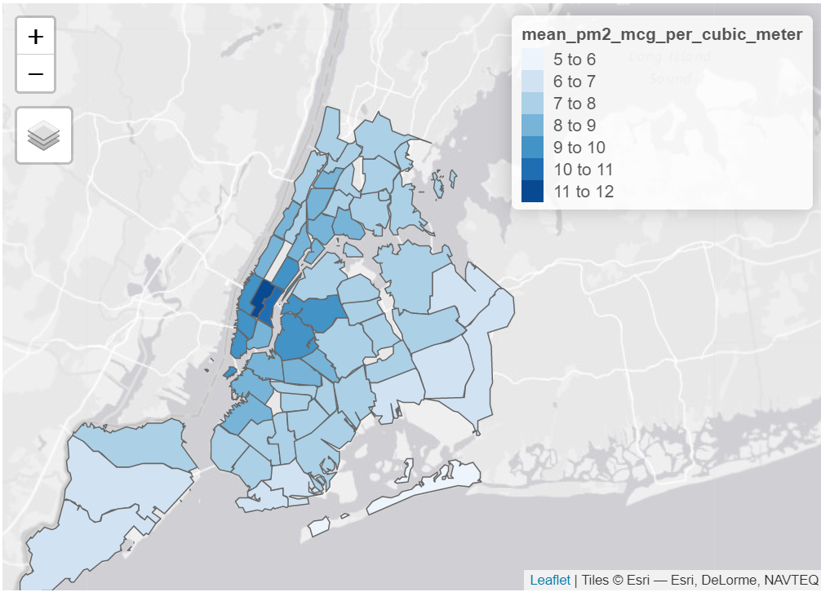
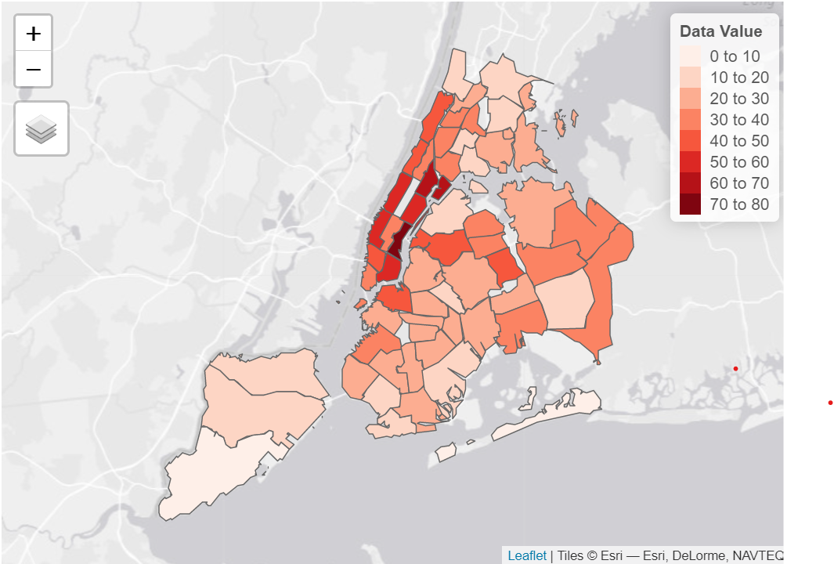
Results
PM2.5 Map
Annual Traffic Density Map
Looking at PM2.5 levels in different community districts, CDs with the highest PM2.5 levels are in Manhattan followed by some CDs in Brooklyn, Queens and Bronx. What could be the cause of this?
According to the NYC.gov EH data portal, traffic is a major source of PM2.5.
So, I looked at the traffic information. It does show that Manhattan CDs have the highest levels of traffic.
Notes:
Here in the map on the left we see that the community districts with the highest PM2.5 levels are in Manhattan followed by some CDs in Brooklyn, Queens and Bronx. So, why is that happening?
Looking at the second map on the right we see that Manhattan community districts have the highest levels of traffic and so that explains the high PM2.5 levels.

Slide 6
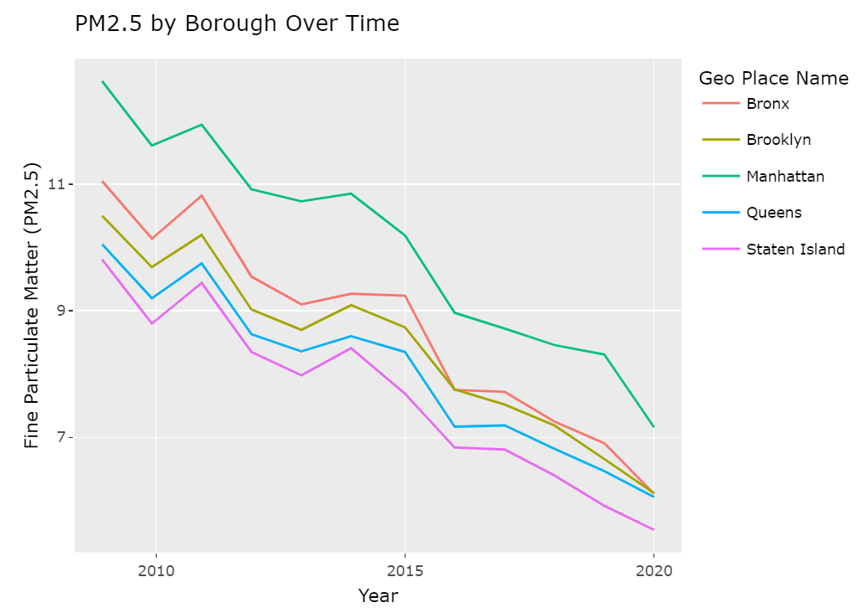
PM2.5 levels by NYC Boroughs
The good news is PM2.5 levels has been constantly decreasing in all boroughs in New York City.
Looking at years beginning in 2008 to 2020 we see a decreasing trend by all boroughs
Manhattan is the borough with the highest levels of PM2.5.
Notes:
Looking at this line plot we can clearly see that PM2.5 levels has been constantly decreasing in all boroughs in New York City over the years.

Slide 7
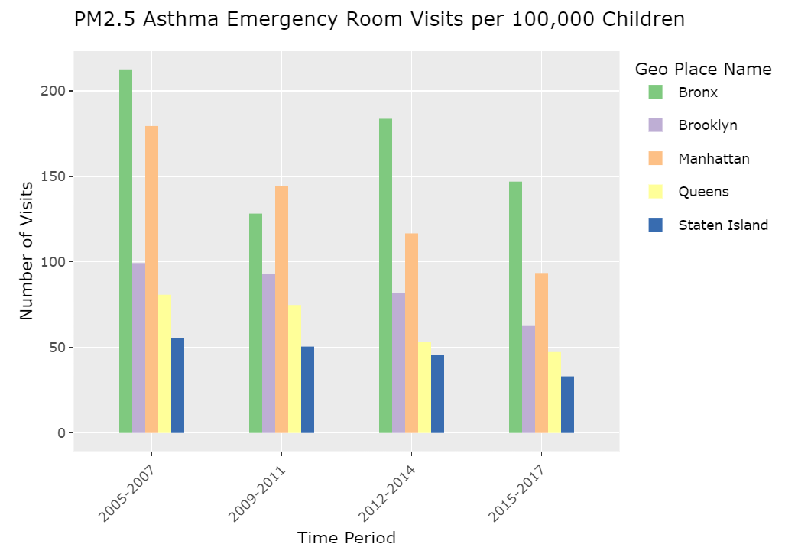
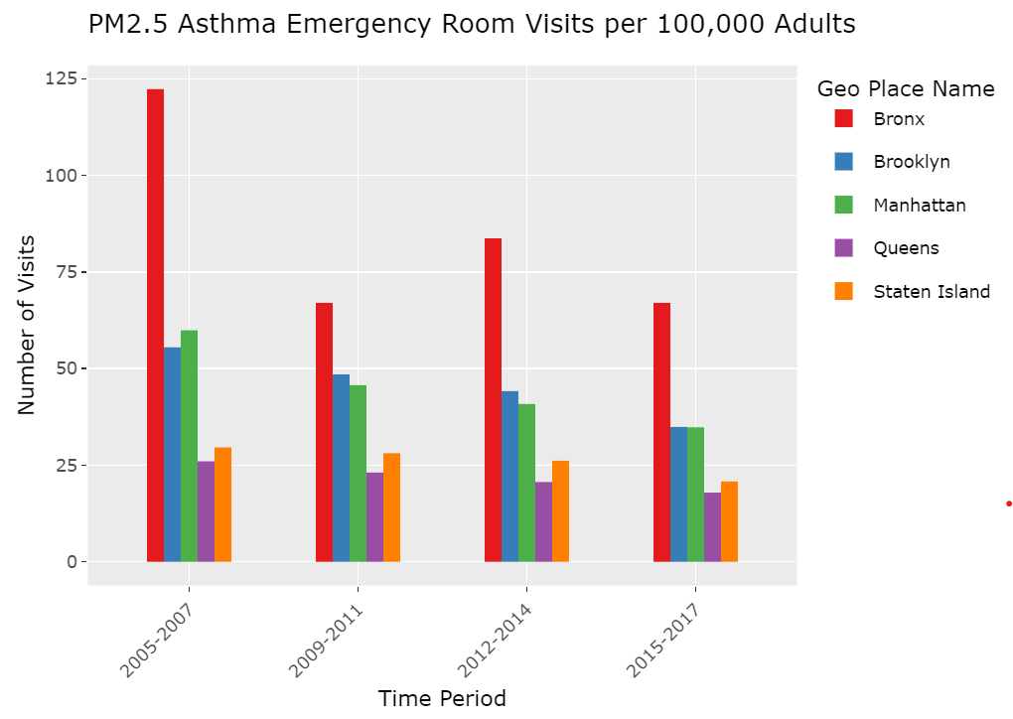
PM2.5 ER visits by Children
PM2.5 ER Visits by Adults
PM2.5 attributable asthma emergency room visits for children has been decreasing in every borough. The borough with the highest number of PM2.5 attributable asthma related emergency room visits for children is Bronx.
PM2.5 attributable asthma emergency room visits for adults has been decreasing in every borough. The borough with the highest number of PM2.5 attributable asthma related emergency room visits for adults is Bronx.
Overall, the number of asthma related emergency room visits is greater for children than adults.
Notes:
These graphs show that emergency room visits due to asthma because of PM2.5 by both children and adults has been decreasing in every borough in NYC over the years. However, the ER visit rates for children are way higher than adults. Bronx has the highest rates of ER visits.

Slide 8
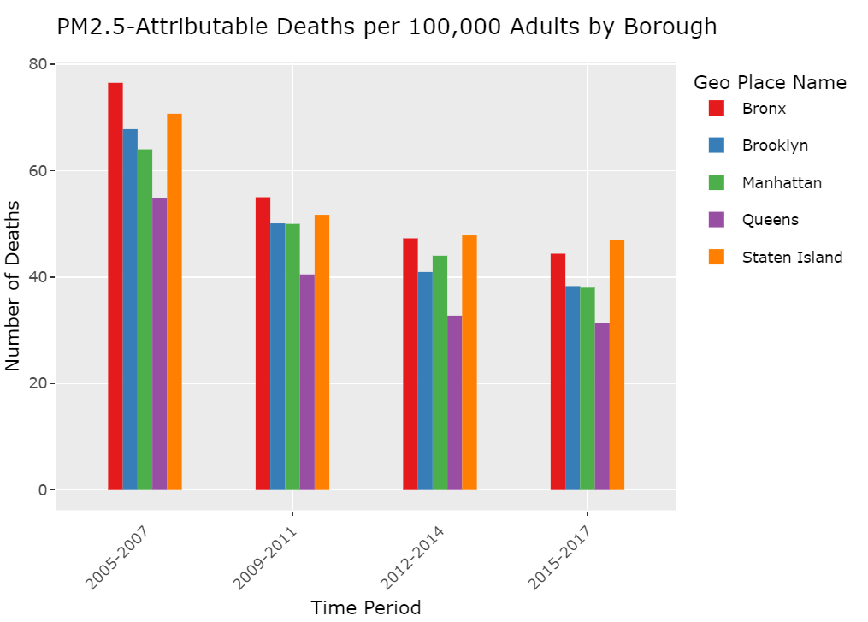
Adult Deaths Attributable to PM2.5
PM2.5-Attributable Deaths per 100,000 Adults has been decreasing in each borough.
The two boroughs with the highest number of PM2.5 attributable deaths per 100,000 adults is Bronx and Staten Island.
Notes:
Deaths due to PM2.5 have also been decreasing over the years but they are the highest in Staten Island followed by Bronx.

Slide 9
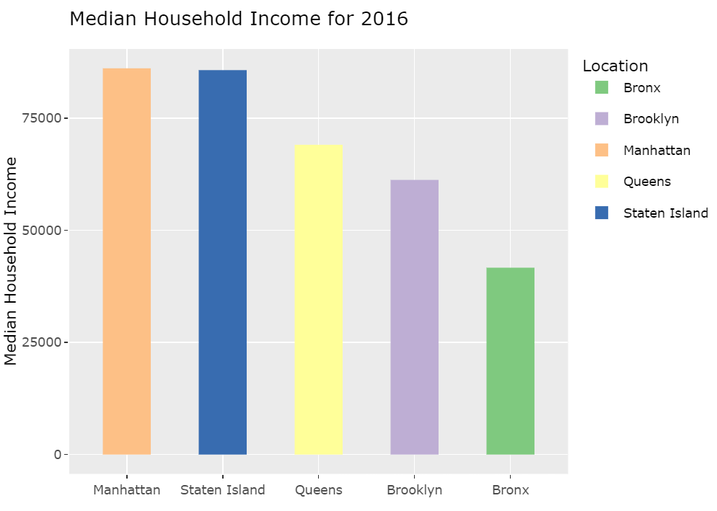
Average Annual Income
We can see from this bar graph that the borough with the lowest median household income for 2016 is Bronx.
Therefore, the borough with the highest PM2.5 attributable hospital visits is also the borough with the lowest income.
Notes:
Bronx has the lowest income and Manhattan and Staten Island have the highest.

Slide 10
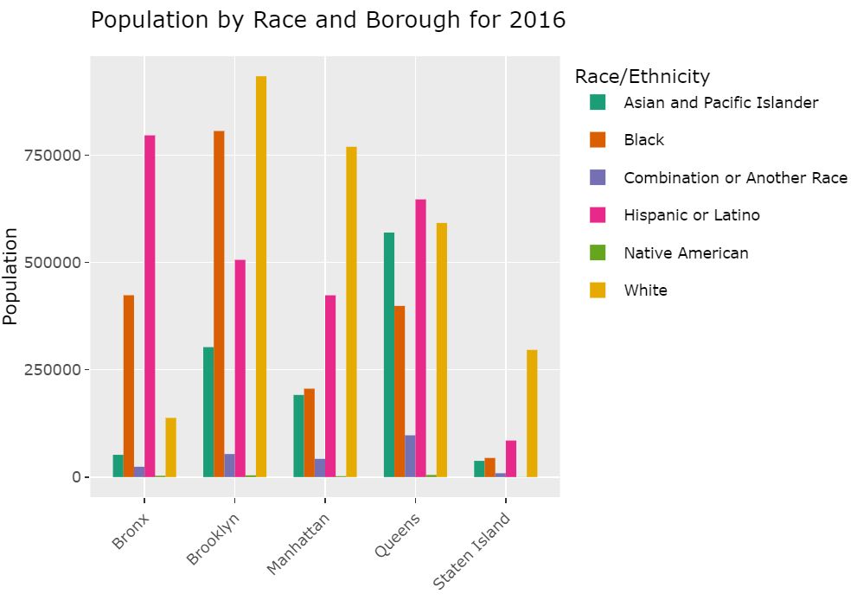
Population, Race by Borough
The borough with the lowest income is Bronx
It has high population of people that are Hispanic or Latino.
Notes:
We have already seen that Bronx has the lowest income. It also has a high population of Hispanic/ Latino.

Slide 11
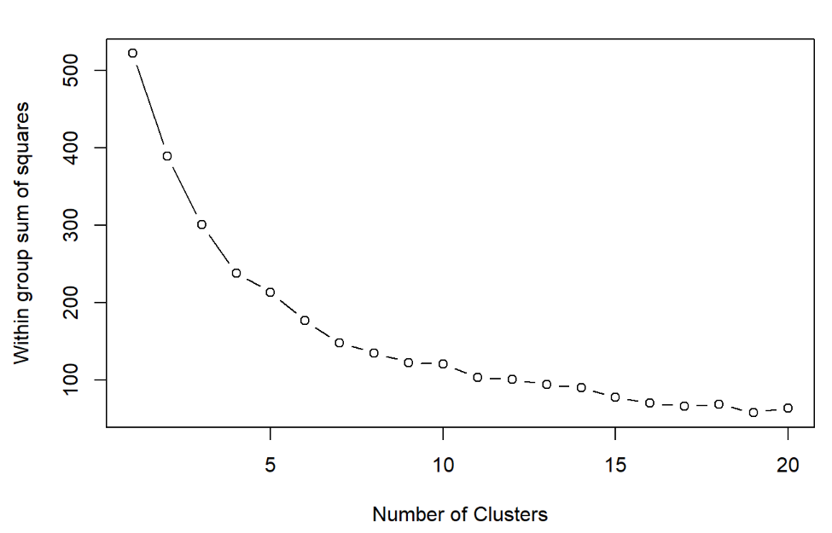
Scree Plot
Here I have added a Scree plot to determine the number of clusters to use with K-means.
The scree plot suggests about 4.
Notes:
For K-means clustering I created a scree plot here. It looks like 4 is a good number for clusters.

Slide 12
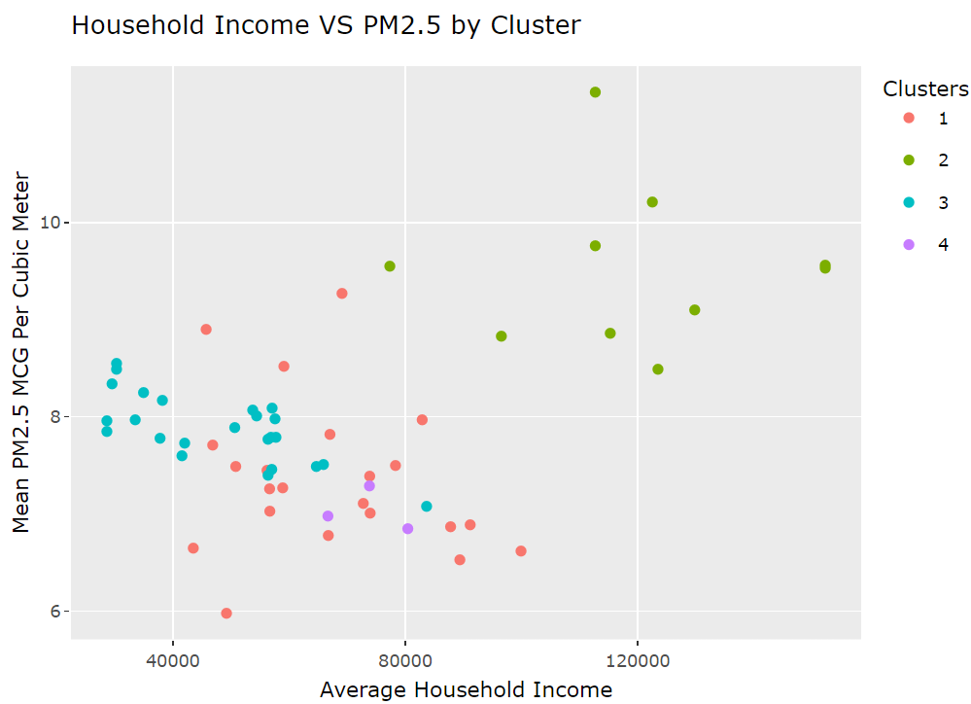
Population, Race by Borough
The K-mean cluster plot shows that most of the community districts with higher level of PM2.5 are in Manhattan which is the second highest borough in terms of income.
However, it is important to note that the community districts in Manhattan that have lower levels of PM2.5 have the highest incomes.
Lower income CDs in Manhattan have high levels of PM2.5.
Notes:
Here I created a k-means cluster plot that shows that most of the community districts with higher level of PM2.5 are in Manhattan which is the second highest borough in terms of income.
Most CDs with the highest incomes in Manhattan have lower PM2.5

Slide 13
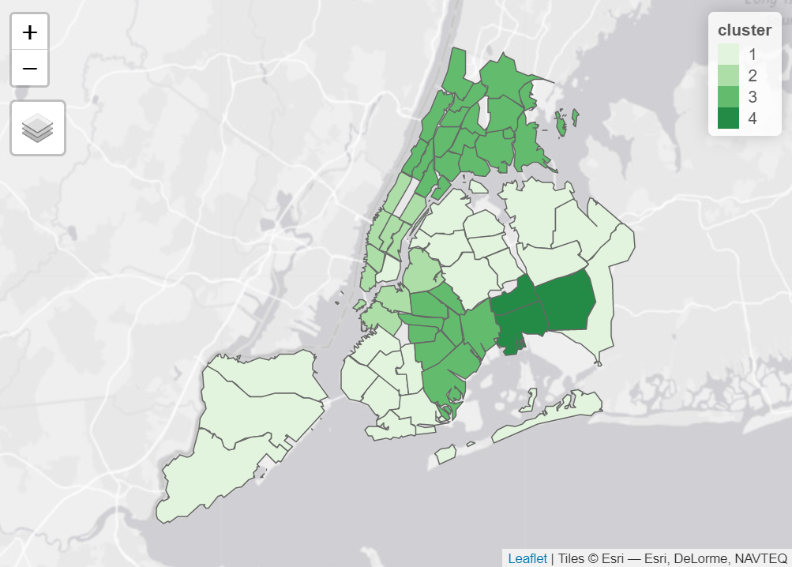
Map of the Clusters
Plotting the clusters from K-means, shows that –
CDs with similar characteristics in terms of income, ethnicity and PM2.5 levels are grouped together in similar nearby neighborhoods.
Manhattan in cluster 2 has higher PM2.5 levels.
Notes:
Here I have plotted the clusters from k-means.
We see that CDs with similar characteristics in terms of income, ethnicity and PM2.5 levels are grouped together in similar nearby neighborhoods.
And Manhattan in cluster 2 has higher PM2.5 levels.

Slide 14
Key Findings
The Manhattan borough in NYC has some of the highest levels of PM2.5
Manhattan also has the highest levels of traffic.
PM2.5 levels have been falling in all NYC boroughs since 2008
Children visit the emergency room for PM2.5 related asthma at a much higher rate than adults
Bronx has the lowest average income, but the highest rates of emergency room visits even though the PM2.5 level in Bronx is lower than Manhattan and have fallen to the same levels as Brooklyn and Queens.
Most interesting finding – Staten Island with a high average income and low PM2.5 levels has the most PM2.5 attributable deaths.
Notes:
My major findings are:
Manhattan in NYC has some of the highest levels of PM2.5 as well as the highest levels of traffic.
PM2.5 levels have been falling in all NYC boroughs since 2008
Children visit the emergency room for PM2.5 related asthma at a much higher rate than adults
Bronx has the lowest average income, but the highest rates of emergency room visits although the PM2.5 level in Bronx is lower than Manhattan.
My most interesting finding is that Staten Island which has a high average income and low PM2.5 levels has the most PM2.5 attributable deaths. What could be causing that?

Slide 15
Conclusions
These results suggest that higher levels of PM2.5 in the air has a direct correlation with the amount of traffic as seen in the case of Manhattan.
Lower income areas and areas with large Hispanic and African American populations have some of the highest levels of critical illness or death.
The areas with the greater amounts of pollutants are the same areas with the highest median household income.
This suggests that having better paying jobs and higher income allows members of the community to remedy health problems more effectively.
Some of the implications of this study include better access to healthcare and more clinics in poorer neighborhoods.
Reduced drug prices for lower income families will make drugs more affordable for people suffering from asthma.
This improved level of access to better healthcare will reduce the number of PM2.5 attributable hospital visits and deaths for people living in poorer communities.
In order to understand why Staten Island has a highest death rate attributable to PM2.5 we need to perform a deeper analysis of the area. We need to look at income, demographics and pollution levels at the census tract or even block group levels.
Notes:
We can see from the study that higher levels of PM2.5 in the air has a direct correlation with the amount of traffic as we have seen in the case of Manhattan.
In addition, lower income areas/ areas with large Hispanic and African American populations have some of the highest levels of critical illness or death like Bronx.
The areas with the greater amounts of pollutants are the same areas with the highest median household income.
This suggests that having better paying jobs and higher income allows people to access better healthcare and remedy health problems more effectively. They have better health insurance, better clinics, hospitals etc.
Some of the implications of this study include better access to healthcare and more clinics in poorer neighborhoods can improve the situation with PM2.5 related asthma.
Reduced drug prices for lower income families will make drugs more affordable for people suffering from asthma.
This improved level of access to better healthcare will reduce the number of PM2.5 related hospital visits and deaths for people living in poorer neighborhoods.
Last but not least for us to understand why Staten Island has a highest death rate attributable to PM2.5 we need to perform a deeper analysis of the area. We need to look at income, demographics and pollution levels at the census tract or even block group levels.

